Slide 1



chapter 2
The Computer

Slide 2
The Computer
In order to understand how humans interact with computers, we need to have an understanding of both parties in the interaction.
This chapter considers the computer and its associated input–output devices and investigates how the technology influences the nature of the interaction and style of the interface.
What happens when we (as people) interact with each other?
  We are either passing information to other people, or receiving information from them.
  Often, the information we receive is in response to the information that we have recently imparted to them, and we may then respond to that.
  Therefore, interaction is a process of information transfer.

Slide 3
The Computer
Relating this to the electronic computer, the same principles hold:
  Interaction is a process of information transfer, from the user to the computer and from the computer to the user.
The details of computer processing should largely be irrelevant to the end-user, but
  Interface designer needs to be aware of the limitations of storage capacity and computational power.
  Software designers often have high-end machines on which to develop applications.

Slide 4
The Computer
The following section of this chapter concentrates on the transference of information from the user to the computer and back.
Moreover, they consider the computer itself, its processor and memory devices and the networks that link them together.
The computer system comprises various elements (e.g., input devices, output devices, and etc.), each of which affects the user of the system.

Slide 5
The Computer
A computer system is made up of various elements, each of these elements affects the interaction:
  input devices – text entry and pointing
  output devices – screen (small&large), digital paper
  virtual reality – special interaction and display devices
  physical interaction – e.g. sound, haptic, bio-sensing
  paper – as output (print) and input (scan)
  memory – RAM & permanent media, capacity & access
  processing – speed of processing, networks

Slide 6

Interacting with Computers
to understand human–computer interaction
… need to understand computers!
what goes in and out
devices, paper,
sensors, etc.
what can it do?
memory, processing,
networks

Slide 7
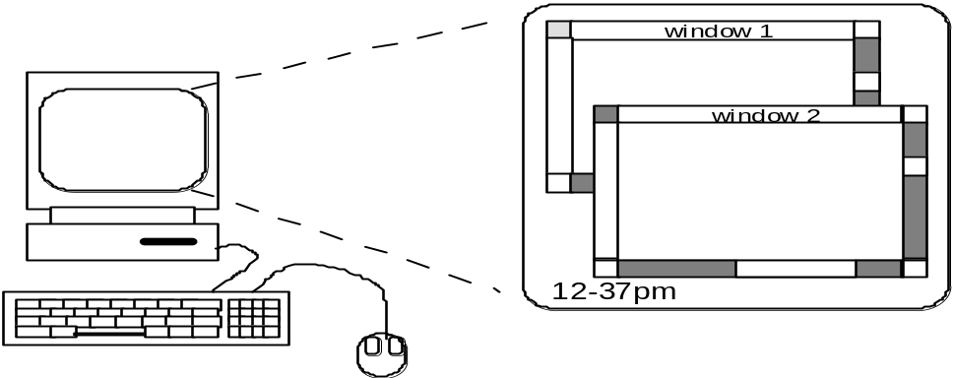
A ‘typical’ Computer System
?
screen, or monitor, on which there are windows
keyboard
mouse/trackpad
variations
  desktop
  laptop
  PDA
  The devices dictate the styles of interaction that the system supports.
  If we use different devices, then the interface will support a different style of interaction.

Slide 8

How Many …
computers in your house?
  hands up, …
  … none, 1, 2 , 3, more!!
computers in your pockets?
are you thinking …
… PC, laptop, PDA ??

Slide 9
How Many Computers …
in your house?
  PC
  TV, VCR, DVD, HiFi, cable/satellite TV
  microwave, cooker, washing machine
  central heating
  security system
  can you think of more?
in your pockets?
  PDA
  phone, camera
  smart card, card with magnetic strip?
  electronic car key
  USB memory
  try your pockets and bags

Slide 10
Interactivity?
Long ago in a galaxy far away … batch processing
  punched card stacks or large data files prepared
  long wait ….
  line printer output
  … and if it is not right …
Now most computing is interactive
  rapid feedback
  the user in control (most of the time)
  doing rather than thinking …
Is faster always better?

Slide 11
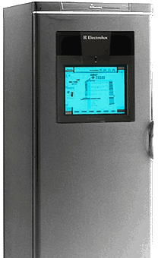

Richer Interaction
sensors
and devices
everywhere

Slide 12
Text Entry Devices
keyboards (QWERTY et al.)
chord keyboards, phone pads
handwriting, speech

Slide 13
Keyboards
The plain keyboard is the most obvious means of text entry (most common).
  Allows rapid entry of text by experienced users
  Usually connected by cable, but can be wireless
There are several variations for the text entry such as:
  Different keyboard layouts (chord keyboards, Qwerty Keyboards, Dvorak keyboards, etc)
  Handwriting Recognition
  Speech Recognition
How keyboards work?

Slide 14
QWERTY Keyboards
Proposed by Charles Sholes in 1868.
The layout of the digits and letters on a QWERTY keyboard is fixed, but non-alphanumeric keys vary between keyboards.
  For example, there is a difference between key assignments on British and American keyboards.
The QWERTY arrangement of keys is not optimal for typing.
  layout to prevent typewriters jamming!
Alternative designs allow faster typing but large social base of QWERTY typists produces reluctance to change.

Slide 15
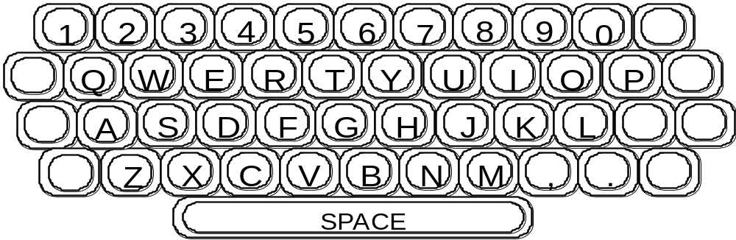
QWERTY Keyboards

Slide 16
Alternative Keyboard Layouts
(DVORAK Keyboard )
Designed in 1930’s by August Dvorak.
The DVORAK keyboard uses a similar layout of keys to the QWERTY system, but assigns the letters to different keys.
  Keeping the most commonly used keys on the home or middle
  Biased towards right hand
  Common combinations of letters alternate between hands
  70% of keystrokes are made without the typist having to stretch far
  10-15% improvement in speed and reduction in fatigue
  But - large social base of QWERTY typists produce market pressures not to change

Slide 17
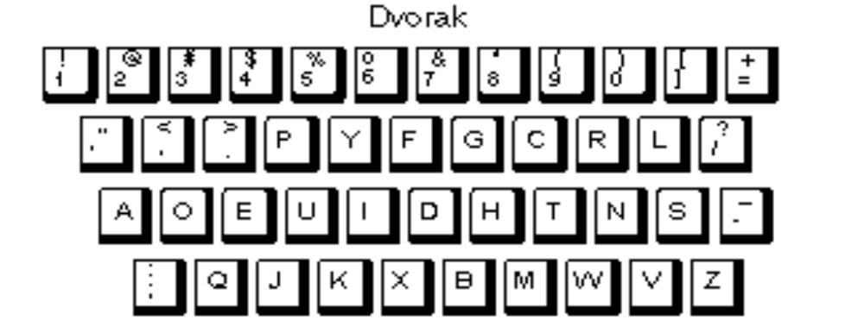
Alternative Keyboard Layouts
(DVORAK Keyboard )

Slide 18
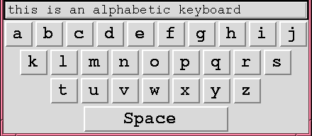
Alternative Keyboard Layouts
(Alphabetic Keyboard )
Alphabetic
  keys arranged in alphabetic order
  not faster for trained typists
  not faster for beginners either!

Slide 19
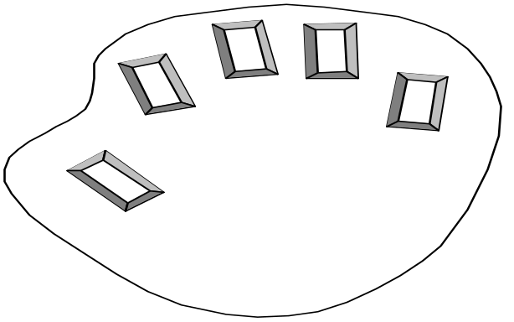
Chord keyboards
Chord keyboard as a data entry input device was first seriously investigated in the mid-1950s by the Canadian Post Office.
Chord keyboards are significantly different from normal alphanumeric keyboards.
Only a few keys (four or five) are used.
Letters are produced by pressing one or more of the keys at once.
Ideal for portable applications

Slide 20
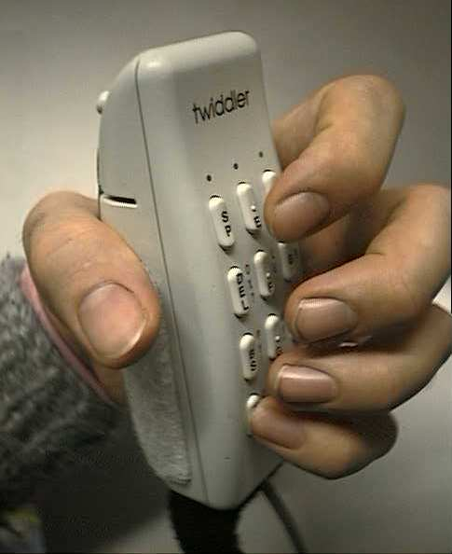
Chord keyboards
Advantages:
  Very Small (palm sized).
  Can be used by one hand.
  Learning time is hours.
  Faster than conventional keyboards.
Disadvantages:
  Fatigue - hard to use for long time.
  Social resistance

Slide 21
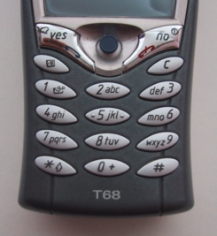
Phone Pad and Numeric Keypads
Phone Pad:
use numeric keys with multiple presses
  2 – a b c 6 - m n o
  3 - d e f 7 - p q r s
  4 - g h i 8 - t u v
  5 - j k l 9 - w x y z
hello = 4433555[pause]555666
surprisingly fast!

Slide 22

Phone Pad and Numeric Keypads
Numeric Keypads:
For entering numbers quickly
  calculator, PC keyboard
For telephones
Not the same!!
ATM like phone
1
2
3
7
8
9
4
5
6
4
5
6
7
8
9
1
2
3
*
0
#
0
.
=
telephone
calculator

Slide 23
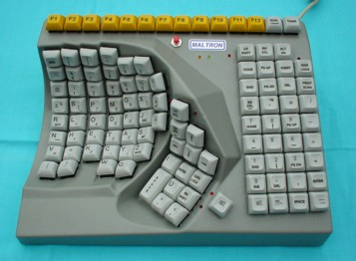
Special Keyboards
Designs to reduce fatigue for repetitive strain injury (RSI)
For one handed use
  e.g. the Maltron left-handed keyboard

Slide 24
Handwriting Recognition
Handwriting recognition is an attractive method of text entry
Text can be input into the computer, using a pen and a digesting tablet
  natural interaction
Technical problems carried heavy limitations in two key areas:
  Character extraction
    individual characters are recognised by ease but diﬃcult to interpret handwriting with no distinct separation between characters.
    coping with different styles of handwriting.

Slide 25
Handwriting Recognition
  Feature extraction
    Individual properties of symbols were hard-coded (aspect ratio, pixel distribution, number of strokes, distance from the image centre, and reﬂection). This requires development time.
Used in PDAs, and tablet computers …
… leave the keyboard on the desk!

Slide 26
Speech Recognition
Speech recognition is a promising area of text entry.
Improving rapidly
Only used in very limited situations
Most successful when:
  single user – initial training and learns peculiarities
  limited vocabulary systems
Problems with
  external noise interfering
  imprecision of pronunciation
  large vocabularies
  different speakers

Slide 27
Positioning, Pointing and Drawing
mouse, touchpad
trackballs, joysticks etc.
touch screens, tablets
eyegaze, cursors

Slide 28
Pointing Devices
Pointing devices allow the user to point, position and select items.
Either directly or by manipulating a pointer on the screen.
Many pointing devices can also be used for free-hand drawing.
Although the skill of drawing with a mouse is very different from using a pencil.

Slide 29
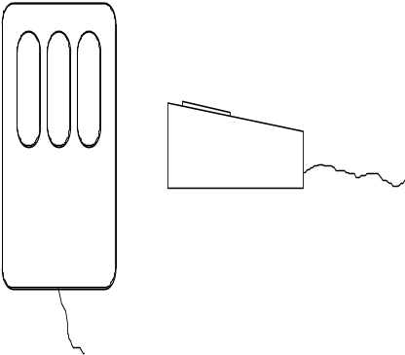
The Mouse
The mouse has become a major component of the majority of desktop computer systems sold today.
Handheld pointing device
  very common
  easy to use
Two characteristics
  planar movement
  buttons
    (usually from 1 to 3 buttons on top, used for making a selection, indicating an option, or to initiate drawing etc.)

Slide 30
How does it work?
Two methods for detecting motion
  Mechanical
    ball on underside of mouse turns as mouse is moved
    can be used on almost any flat surface
  Optical
    light emitting diode on underside of mouse
    may use special grid -like pad or just on desk
    less susceptible to dust and dirt

Slide 31
Even by Foot …
some experiments with the footmouse
  controlling mouse movement with feet
  not very common
but foot controls are common elsewhere:
  car pedals
  sewing machine speed control
  piano pedals

Slide 32
Touchpad
The first touch pad was invented by George E. Gerpheide in 1988.
Apple Computer was the first to license and use the touch pad in its Powerbook laptops in 1994.
The touch pad has since become the leading cursor controlling device in laptops.
Also called a glide pad, glide point, trackpad.
touchpad is an input device on laptops and some keyboards.
It can be used in place of an external mouse.
A touch pad works by sensing the user's finger movement and downward pressure.

Slide 33
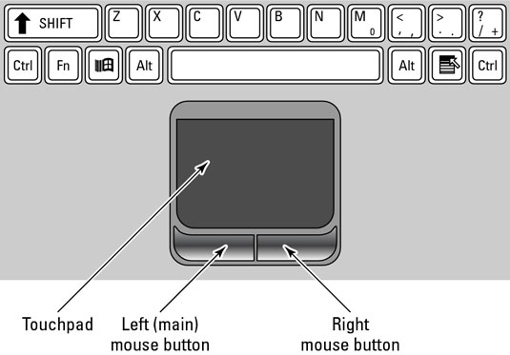
Touchpad

Slide 34
Touchpad
The touch pad contains several layers of material:
  The top layer is the pad that you touch
  Separated electrodes in form a grid (horizontal and vertical rows)
  Circuit board
  The layers with electrodes are charged with a constant alternating current (AC).
As the finger approaches the electrode grid, the current is interrupted and the interruption is detected by the circuit board.
The initial location where the finger touches the pad is registered.
Subsequent finger movement will be related to that initial point.

Slide 35
Trackball
Trackball is a pointing input device, used to enter motion data into computers or other electronic devices.
  ball is rotated inside static housing
    like an upsdie down mouse!
  relative motion moves cursor
  indirect device
  fairly accurate
  separate buttons for picking
  very fast for gaming
Trackballs were common on portable and notebook computers (such as the BlackBerry Tour) where there may be no desk space on which to run a mouse.
Trackballs are common on CAD workstations for easy precision, before the advent of the touchpad.

Slide 36
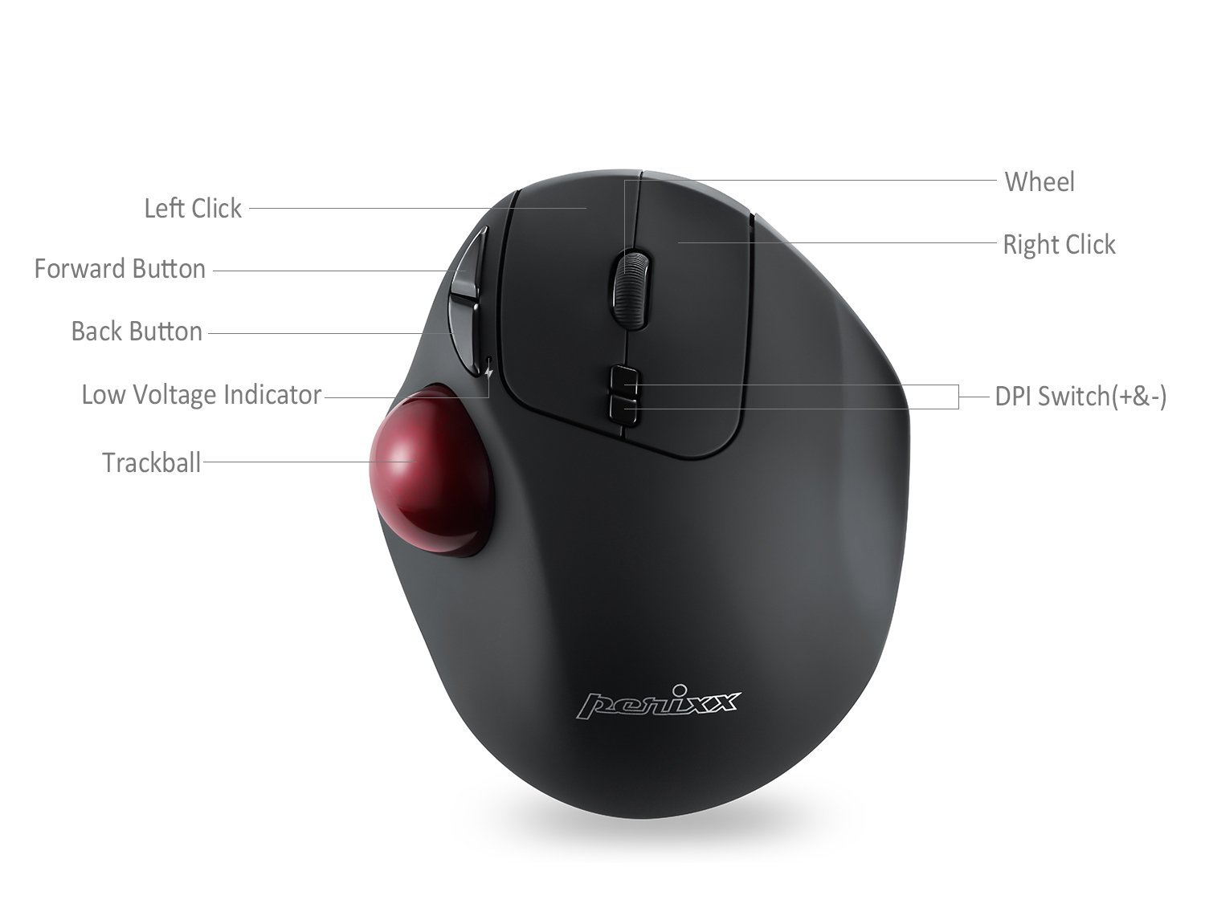
Trackball

Slide 37
Joystick
Joystick is an indirect input device, taking up very little space. Consisting of a small palm-sized box with a stick.
  inexpensive
  fairly robust
  familiarity to users
For this reason they are found in market for computer games.
  Also used for aircraft controls and 3D navigation.

Slide 38
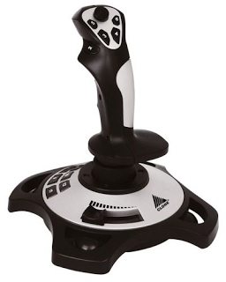
Joystick
Joystick

Slide 39
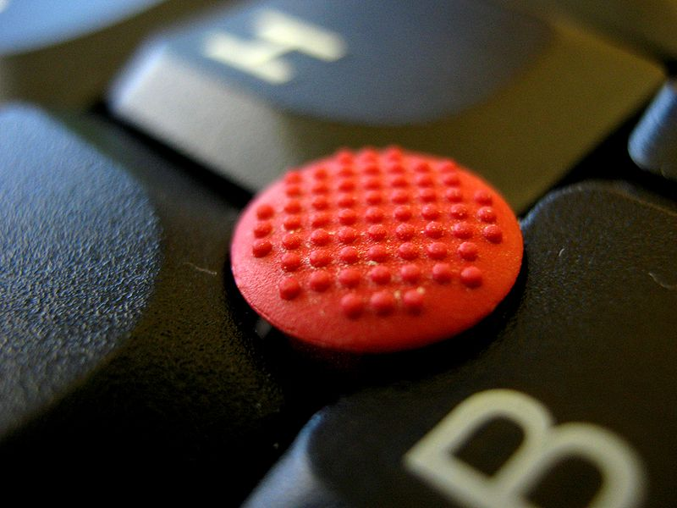
Keyboard Nipple
Keyboard nipple
  For laptop computers.
  Miniature joystick in the middle of the keyboard, between the G, H, and B keys.
  Operated by pushing in the general direction the user wants the cursor to move.

Slide 40
Touch-Sensitive Screen
A touch screen is a both input and output device . The screens are sensitive to pressure; a user interacts with the computer by touching pictures or words on the screen.
Detect the presence of finger or stylus on the screen.
There are three types of touch screen technology:
  Resistive is coated with a thin metallic electrically conductive and resistive layer that causes a change in the electrical current which is registered as a touch event and sent to the controller for processing.
    Affordable
    Offer only 75% clarity
    Can be damaged by sharp objects
    Not affected by outside elements such as dust or water

Slide 41
Touch-Sensitive Screen
There are three types of touch screen technology:
  Capacitive is touch screen and coated with a material that stores electrical charges.
  When the panel is touched, a small amount of charge is drawn to the point of contact.
  Circuits located at each corner of the panel measure the charge and send the information to the controller for processing.
    Capacitive touch screen panels must be touched with a finger
      unlike resistive and surface wave panels that can use fingers and stylus
    not affected by outside elements
    have high clarity

Slide 42
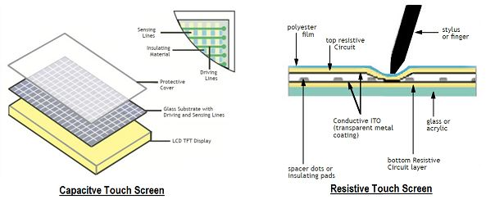
Touch-Sensitive Screen

Slide 43
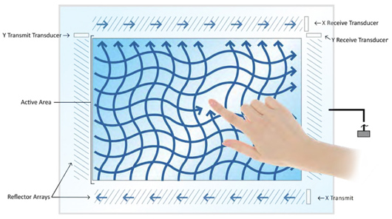
Touch-Sensitive Screen
There are three types of touch screen technology:
  Surface wave is technology uses ultrasonic waves that pass over the touch screen.
  When the panel is touched, a portion of the wave is absorbed and registers this change then sends this information to the controller for processing.
    Most advanced of the three types
    But can be damaged by outside elements

Slide 44
Stylus and Light Pen
Stylus
  Small pen-like pointer to draw directly on screen
    Like a tiny ink pen but uses pressure instead of ink
  May use touch sensitive surface or magnetic detection
  Used in PDA, tablets PCs and drawing tables
Light Pen
  Now rarely used
  Uses light from screen to detect location
BOTH …
  Very direct and obvious to use
  But can obscure screen

Slide 45
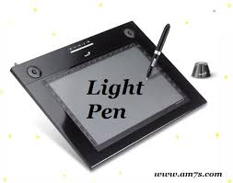

Stylus and Light Pen
Stylus Pen Light Pen

Slide 46
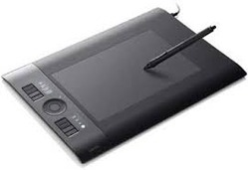
Digitizing Tablet
Digitizing Tablet
  An input device that enables you to enter drawings and sketches into a computer.
A digitizing tablet consists of an electronic tablet and a cursor or pen.
  used on special surface
  very accurate
  used for digitizing maps

Slide 47
Eye gaze
also called eye tracking is a way of accessing your computer or communication aid using a mouse that you control with your eyes.
control interface by eye gaze direction
  e.g. look at a menu item to select it
uses laser beam reflected off retina
  a very low power laser!

Slide 48
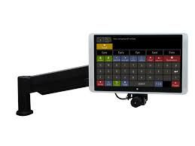
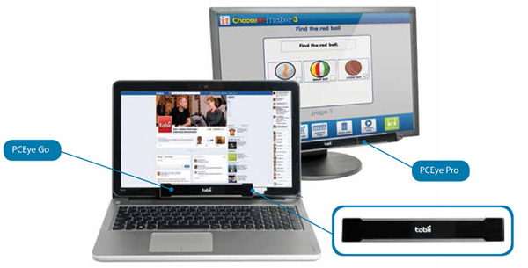
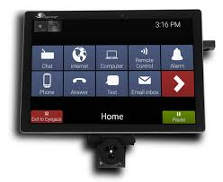
Eye gaze
Eye gaze

Slide 49
Cursor Keys
The cursor keys or arrow keys are keyboard keys that move the pointer (cursor) on screen.
  Four keys (up, down, left, right) on keyboard.
  Provided for interactive navigation on a computer system.
  Historically there have been many different arrangements.
  No standard layout has been the inverse-T layout, most common.
  Useful for not much more than basic motion for text-editing tasks.

Slide 50
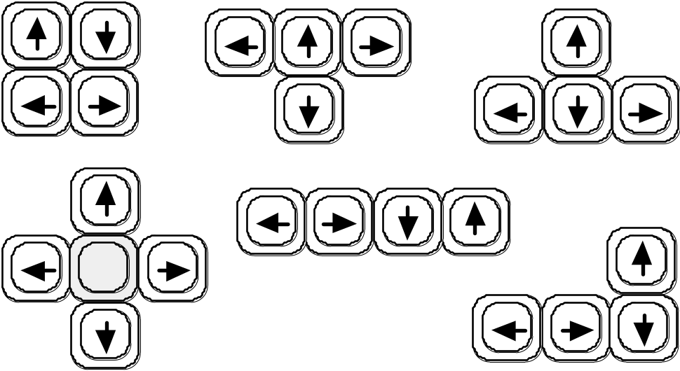
Cursor Keys

Slide 51
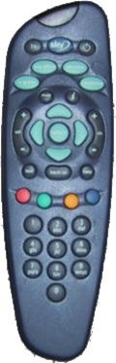
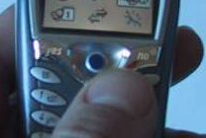
Discrete Positioning Controls
in phones, TV controls etc.
  cursor pads or mini-joysticks
  discrete left-right, up-down
  mainly for menu selection

Slide 52
display devices
bitmap screens (CRT & LCD)
large & situated displays
digital paper

Slide 53
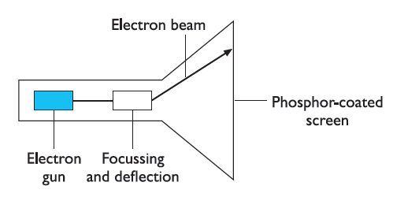
CRT
CRT (Cathode Ray Tube) is the computer screen that works in a similar way to a standard television screen
  similar way to a standard television screen.
  stream of electrons is emitted from an electron gun.
  focused and directed by magnetic fields.
  the beam hits the phosphor-coated screen.
  phosphor is excited by the electrons and glows.

Slide 54
CRT
The electron beam is scanned from left to right, then flicked back to rescan the next line, from top to bottom.
This is repeated, at about 30 Hz (that is, 30 times a second) per frame.
Although higher scan rates are sometimes used to reduce the flicker on the screen.

Slide 55
LCD
LCD (Liquid Crystal Display) is a flat-panel display that uses the light modulating properties of liquid crystals.
Liquid crystals do not emit light directly.
LCD consists primarily of two plates of glass with a thin layer of liquid crystal solution sandwiched between them.
  The top plate is transparent and polarized.
  The bottom plate is reflective.
The type of liquid crystals used in LCD panels have very specific properties that enable them to serve as effective that open and close to block or let light through in response to an electric current.
The liquid crystals is controlled on current by a voltage applied between the glass plates via transparent electrodes that form a grid.

Slide 56
LCD
As the electric current passes through these liquid crystals, they untwist to varying degrees, depending on the voltage applied.
This untwisting effect will change the polarization of the light passing through the LCD panel.
More or less light is able to pass through the polarized filter on the face of the LCD.
Intersecting grid points represent picture elements (pixels).
In a color LCD panel, each pixel is made up of three liquid crystal cells.
Each of those three cells contains a red, green, or blue filter.
Light passing through the filtered cells creates the colors seen on the LCD.

Slide 57
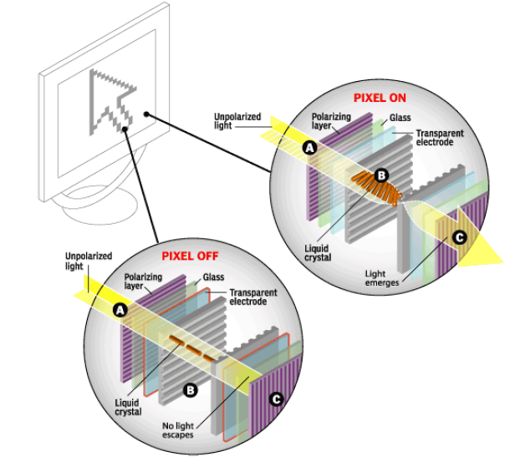
LCD

Slide 58
Advantages of LCD
Advantages of LCD Displays:
  Easier to manufacture.
  Have higher resolution because several million pixels can be etched onto one chip.
  Can be much smaller.
Other Display Technologies
  LED (Light-Emitting Diode)
  Gas Plasma
  DLP (Digital Light Processing)
See the following figures

Slide 59
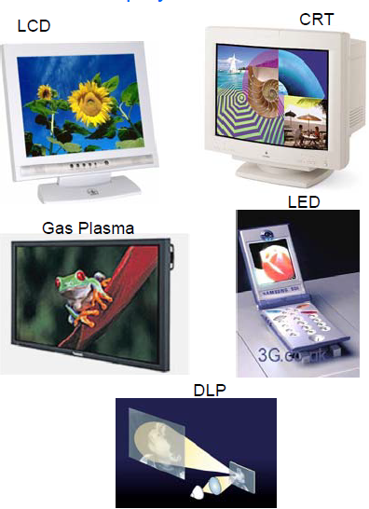
LCD

Slide 60
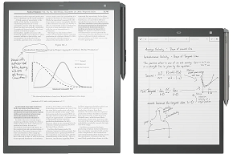
Digital Paper
Digital paper is a new form of ‘display’ that is still in its infancy is the various forms of digital paper.
Digital papers are thin flexible materials that can be written to electronically, just like a computer screen.
but which keep their contents even when removed from any electrical supply.

Slide 61
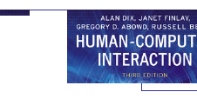


Bitmap Displays
screen is vast number of coloured dots

Slide 62
Bitmap Displays -
Resolution and Color
Virtually all computer displays are based on some sort of bitmap.
Display is made of vast numbers of colored dots or pixels in a rectangular grid.
These pixels may be limited to:
  Black and white
    for example, the small display on many TV remote controls
  Grayscale
  Full color
In monochrome screens, the intensity at each pixel is held by the computer’s video card.
More bits per pixel give rise to more color or intensity possibilities.
  For example, 8 bits/pixel give rise to 2^8 = 256 possible colors at any one time.

Slide 63
Bitmap Displays -
Resolution and Color
Resolution is used in a confused way for screens. There are two numbers to consider:
  The total number of pixels
    in standard computer displays this is always in a 4:3 ratio
    perhaps 1024 pixels across by 768 down, or 1600 × 1200
  The density of pixels
    measured in pixels per inch
Monitors, LCDs screen or other display devices will quote their maximum resolution, but the computer may actually give it less than this.

Slide 64
Virtual Reality and 3D Interaction
positioning in 3D space
moving and grasping
seeing 3D (helmets and caves)

Slide 65
Virtual Reality
Virtual Reality is an artificial environment that is created with software and presented to the user in such a way that the user suspends belief and accepts it as a real environment.
The components necessary for building and experiencing VR are divided into two main components:
  hardware components
  software components

Slide 66
Virtual Reality
The hardware components are divided into five sub-components:
  sensory displays
  tracking system and input devices
  computer workstation
  process acceleration cards
The software components are divided into four sub-components:
  3D modeling software
  2D graphics software
  digital sound editing software
  VR simulation software
See the following figure which depicts the basic components of VR

Slide 67
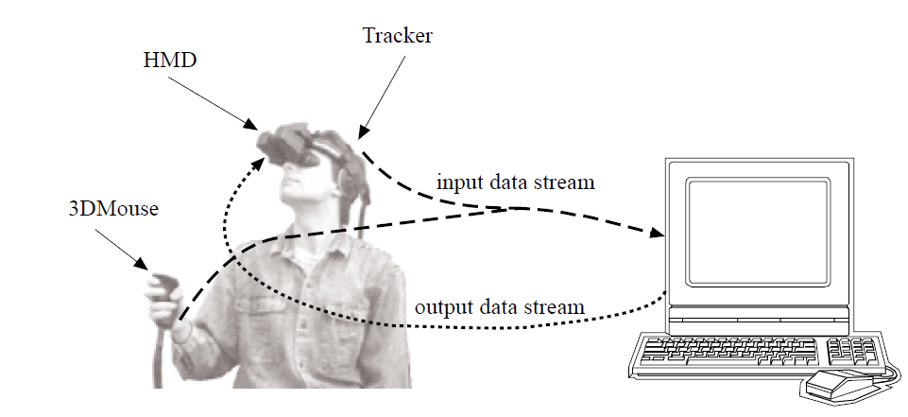
Virtual Reality

Slide 68
VR Hardware Components
Sensory Displays
Sensory displays are used to display the simulated virtual worlds to the user.
The most common sensory displays are:
  computer visual display unit
  HMD
  headphones for 3D audio
HMD (Head Mounted Displays) place a screen in front of each of the viewer's eyes at all times.
Head movement is recognized by the computer, and a new perspective of the scene is generated.
In most cases, a set of optical lens and mirrors are used to enlarge the view to fill the field of view and to direct the scene to the eyes.

Slide 69
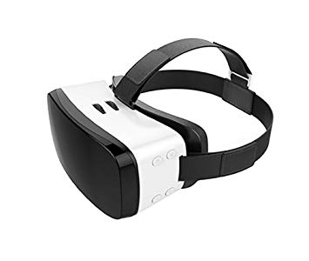
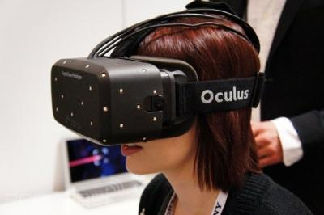
VR Hardware Components
Sensory Displays
HMD (Head Mounted Displays), See the following figure

Slide 70
VR Hardware Components
Tracking System
Tracking system is tracks the position and orientation of a user in the virtual environment.
This system is divided into:
  mechanical trackers
  electromagnetic trackers
  ultrasonic trackers
  infrared trackers

Slide 71
VR Hardware Components
Input Devices
Input Devices are used to interact with the virtual environment and objects within the virtual environment.
Examples are:
  joystick (wand)
  instrumented glove
  keyboard
  voice recognition
  Etc
3D Mouse is in general a joystick-like device that can be moved in space by hand.
  It is equipped with a tracker sensor to determine its position/orientation.
  a few buttons that may trigger some actions.

Slide 72
VR Hardware Components
Input Devices
Gloves are 3D input devices that can detect the joint angles of fingers.
  allows the user richer interaction than the 3D mouse.
  hand gestures may be recognized and translated into proper actions.
The measurement of finger flexion is done with the help by:
  fiber-optic sensors (e.g., VPL DataGlove),
  foil-strain technology (e.g., Virtex CyberGlove)
  resistive sensors

Slide 73
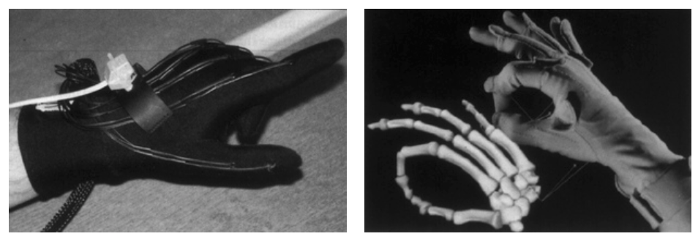
VR Hardware Components
Input Devices
VPL DataGlove
Virtex CyberGlove

Slide 74
3D Space
VR can be applied for:
  The simulation of a real environment for training and education.
  The development of an imagined environment for a game or interactive story.
VR systems present a 3D virtual world.
Users need to navigate through these spaces and manipulate the virtual objects they find there.
The following are some ways for the navigation:
  Cockpit and virtual controls
  3D mouse
  Dataglove
  Whole-body tracking

Slide 75
3D Space
Many arcade games and also more serious applications use controls modeled on an aircraft cockpit to ‘fly’ through virtual space.
In many PC games and desktop virtual reality, the controls are themselves virtual.
May be a simulated form of the cockpit controls or more prosaic up/down left/right buttons.
The user manipulates these virtual controls using an ordinary mouse (or other 2D device).
Rather than just moving the mouse on a tabletop, you can pick the 3D up, move it in three dimensions, rotate the mouse and tip it forward and backward.

Slide 76
3D Space
The 3D mouse has up/down angle (called pitch), left/right orientation (called yaw), and the amount it is twisted about its own axis (called roll).
See the following figure.

Slide 77
Pitch, Yaw and Roll
yaw
roll
pitch

Slide 78
Physical Controls, Sensors etc.
special displays and gauges
sound, touch, feel, smell
physical controls
environmental and bio-sensing

Slide 79
Physical Controls
There are applications (such as such as interactive TV, in-car navigation systems, or personal entertainment) that may have special displays.
  use sound, touch and smell as well as visual displays.
  have dedicated controls and may sense the environment or your own bio-signs.
The traditional computer system (which involves a mouse keyboard and screen) is not relevant or possible for these applications.

Slide 80
Physical Controls
Desktop computer system has to serve many functions and so has generic keys and controls that can be used for a variety of purposes.
In contrast, many dedicated physical control panels have been designed for particular devices.
example:
  Microwave controls
  washing machine player
  personal MiniDisc player

Slide 81

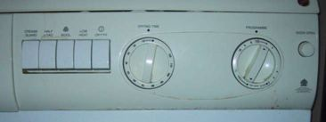
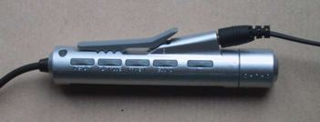
Physical Controls
specialist controls needed …
  industrial controls, consumer products, etc.
easy-clean
smooth buttons
multi-function
control
large buttons
clear dials
tiny buttons

Slide 82
Dedicated Displays
Analogue representations:
  dials, gauges, lights, etc.
Digital displays:
  small LCD screens, LED lights, etc.
Head-up displays
  found in aircraft cockpits
  show most important controls

Slide 83
Sounds
used for error indications
  e.g. beeps, bongs, clonks, whistles and whirrs
used for confirmation of actions
  e.g. keyclick

Slide 84
Touch, Feel, Smell
touch and feeling important
  in games … vibration, force feedback
  in simulation … feel of surgical instruments
  called haptic devices
texture, smell, taste
  current technology very limited

Slide 85
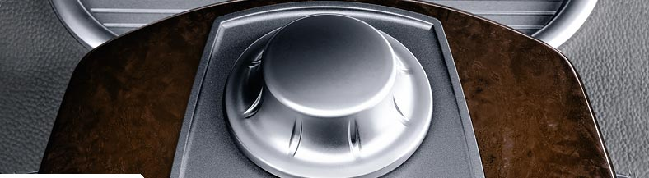
BMW iDrive
for controlling menus
feel small ‘bumps’ for each item
makes it easier to select options by feel
uses haptic technology from Immersion Corp.

Slide 86
Sensors
In a public washroom there are often no controls for the wash basins, you simply put your hands underneath and (hope that) the water flows..
The washbasin is controlled by a small infrared sensor that is triggered when your hands are in the basin.
There are many different sensors available to measure:
  temperature
  movement (ultrasound, infrared, etc.)
  location (GPS, global positioning, in mobile devices)
  weight (pressure sensors)

Slide 87
Sensors
Sensors can also be used to capture physiological signs (our own bodies) such as:
  iris scanners
  body temperature
  heart rate
  galvanic skin response
  blink rate

Slide 88
Sensors -Design Focus
Building systems with physical sensors is no easy task, such as:
  You need a soldering iron
  plenty of experience in electronics
  even more patience
Although some issues are unique to each sensor or project, many of the basic building blocks are similar.
In microprocessors, the basic building blocks:
  connecting simple microprocessors to memory
  connecting simple microprocessors to networks
  connecting various standard sensors (temperature, tilt)

Slide 89
Sensors -Design Focus
Smart-Its is a project which made that job (i.e., Building systems with physical sensors) easier by creating a collection of components and an architecture for adding new sensors.
There are a number of basic Smart-It boards, for example
  Microprocessor with wireless connectivity
  Sensor board including temperature and light
  Power controller
A variety of modules are plugged onto Smart-It boards. See the following figures

Slide 90
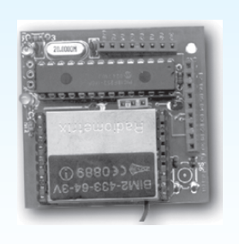
Sensors -Design Focus
The following figure depicts a Smart-It board for a microprocessor with wireless connectivity

Slide 91
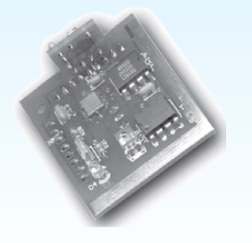
Sensors -Design Focus
The following figure depicts a Smart-It board for a sensor board including temperature and light

Slide 92
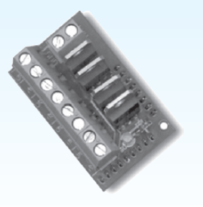
Sensors -Design Focus
The following figure depicts a Smart-It board for a power controller

Slide 93
Paper: Printing and Scanning
print technology
fonts, page description, WYSIWYG
scanning, OCR

Slide 94
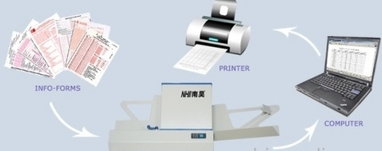
Printing and Scanning
Printing and Scanning is a technology to get information to and from paper.

Slide 95
Printing
Popular printing technologies, like screens, build the image on the paper as a series of dots.
Printing is image made from small dots.
Allows any character set or graphic to be printed.
This resolution is measured in dots per inch (dpi).
Critical features:
  resolution
    size and spacing of the dots
    measured in dots per inch (dpi)
  speed
    usually measured in pages per minute
  cost!!

Slide 96
Types of dot-based Printers
dot-matrix printers
  use inked ribbon (like a typewriter)
  line of pins that can strike the ribbon, dotting the paper
  typical resolution 80-120 dpi
ink-jet and bubble-jet printers
  tiny blobs of ink sent from print head to paper
  typically 300 dpi or better
laser printer
  like photocopier
  dots of electrostatic charge deposited on drum
  picks up toner rolled onto paper which is then fixed with heat
  typically 600 dpi or better.

Slide 97
Printing in The Workplace
shop tills
  dot matrix
  same print head used for several paper rolls
  may also print cheques
thermal printers
  special heat-sensitive paper
  paper heated by pins makes a dot
  poor quality, but simple & low maintenance
  used in some fax machines

Slide 98
Fonts
Font is the particular style of text
  Courier font
  Helvetica font
  Palatino font
  Times Roman font
  _♣×∝≡↵ℜ€⊗↵∼€ (special symbol)
Size of a font measured in points (1 pt about 1/72”)
(vaguely) related to its height
  This is ten point Helvetica
  This is twelve point
  This is fourteen point
  This is eighteen point
  this is twenty-four point

Slide 99


Fonts
Pitch
  fixed-pitch – every character has the same width
    e.g. Courier
  variable-pitched – some characters wider
    e.g. Times Roman – compare the ‘i’ and the “m”
Serif or Sans-serif
  sans-serif – square-ended strokes
    e.g. Helvetica
  serif – with splayed ends (such as)
    e.g. Times Roman or Palatino

Slide 100
Readability of Text
lowercase
  easy to read shape of words
UPPERCASE
  better for individual letters and non-words
  e.g. flight numbers: BA793 vs. ba793
serif fonts
  helps your eye on long lines of printed text
  but sans serif often better on screen

Slide 101
Page Description Languages
Pages very complex
  different fonts, bitmaps, lines, digitised photos, etc.
Can convert it all into a bitmap and send to the printer
… but often huge !
Alternatively Use a page description language
  sends a description of the page can be sent,
  instructions for curves, lines, text in different styles, etc.
  like a programming language for printing!
PostScript is the most common

Slide 102
Screen and Page
WYSIWYG
  what you see is what you get
  aim of word processing, etc.
but …
  screen: 72 dpi, landscape image
  print: 600+ dpi, portrait
can try to make them similar
but never quite the same
so … need different designs, graphics etc, for screen and print

Slide 103
Scanners
Scanners work by shining a beam of light at the page and then recording the intensity and color of the reflection.
  Take paper and convert it into a bitmap
Shines light at paper and note intensity of reflection.
  colour or greyscale
Monochrome scanners are typically only found in multi-function devices.
color scanners usually have monochrome modes for black and white or grayscale copying.
Typical resolutions from 600–2400 dpi.

Slide 104
Scanners
Two sorts of scanner
  flat-bed: paper placed on a glass plate, whole page converted into bitmap
  hand-held: scanner passed over paper, digitising strip typically 3-4” wide

Slide 105
Scanners
Used in
  document storage and retrieval systems
    where paper documents are scanned and stored on computer rather than filing cabinet.
  desktop publishing for incorporating photographs
  special scanners for slides and photographic negatives
Cost
  The costs of maintaining paper records are enormous.
    Storing a bitmap image is neither most useful (in terms of access methods and space efficient)
    scanning may be combined with OCR (Optical Character Recognition).

Slide 106
Optical character recognition
    OCR is the process whereby the computer can ‘read’ the characters on the page.
OCR converts bitmap back into text
different fonts
  create problems for simple _ “template matching” algorithms.
  more complex systems segment text.
    decompose it into lines and arcs, and decipher characters that way.
page format
  columns, pictures, headers and footers

Slide 107
Paper-based Interaction
paper usually regarded as output only
can be input too
  OCR, scanning, etc.
Xerox PaperWorks
  glyphs – small patterns of /\\//\\\
    used to identify forms etc.
    used with scanner and fax to control applications
more recently
  papers micro printed - like wattermarks
    identify which sheet and where you are
  special ‘pen’ can read locations
    know where they are writing

Slide 108
Memory
short term and long term
speed, capacity, compression
formats, access

Slide 109
Memory
The different levels of computer memory are more commonly called primary and secondary storage.
By analogy with the human memory, computer memory can be grouped into:
  short-term (STM )
  long-term memories (LTM)
but the analogy is rather weak – the capacity of the computer’s STM is a lot more than seven items.
The details of computer memory are not in themselves of direct interest to the user interface designer. However, the limitations in capacity and access methods are important constraints on the sort of interface that can be designed.

Slide 110
Short-term Memory - RAM
Most currently active information is held inshort-term memory (RAM).
Different forms of RAM differ as to their precise access times, power consumption and characteristics.
  on silicon chips
  100 nano-second access time
  data transferred at around 100 Mbytes/sec
  Most RAM is volatile (lose information if power turned off)
Most RAM is volatile. However, many computers have small amount of non-volatile RAM, which retains its contents, perhaps with the aid of a small battery.
Typical desktop computers:
  64 to 256 Mbytes RAM

Slide 111
Long-term Memory - Disks
LTM consists of disks, possibly with small tapes for backup.
There are two main kinds of technology used in disks:
  magnetic disks
  optical disks
The most common storage media, floppy disks and hard (or fixed) disks, are coated with magnetic material, on which the information is stored.

Slide 112
Long-term Memory – Disks
Magnetic Disks
Magnetic disks, there are two access times:
  The time taken to find the right track on the disk
  The time to read the track.
example:
  Floppy disks store around 1.4 Mbytes
  Hard disks typically 40 Gbytes to 100s of Gbytes
    access time ~10ms
    transfer rate 100kbytes/s

Slide 113
Long-term Memory – Disks
Optical Disks
Optical disks use laser light to read and (sometimes) write the information on the disk.
More robust that magnetic media
CD-ROM is the most common optical disk.
  Recordable CDs
    form of WORM device (Write-Once Read-Many)
    more flexible
    can be written, but only once at any location
  Rewritable CDs
    rewrite time is typically much slower than the read time
Many CD-ROM reader/writers can also read DVD format
  developed for storing movies and also for AV applications, or very large files

Slide 114
Blurring Boundaries
PDAs
  often use RAM for their main memory
Flash-Memory
  used in PDAs, cameras etc.
  silicon based but persistent
  plug-in USB devices for data transfer

Slide 115
Speed and Capacity
what do the numbers mean?
some sizes (all uncompressed) …
  this book, text only ~ 320,000 words, 2Mb
  the Bible ~ 4.5 Mbytes
  scanned page ~ 128 Mbytes
    (11x8 inches, 1200 dpi, 8bit greyscale)
  digital photo ~ 10 Mbytes
    (2–4 mega pixels, 24 bit colour)
  video ~ 10 Mbytes per second
    (512x512, 12 bit colour, 25 frames per sec)

Slide 116
Virtual Memory
Problem:
  running lots of programs + each program large
  not enough RAM
Solution - Virtual memory :
  store some programs temporarily on disk
  makes RAM appear bigger
But … swopping
  program on disk needs to run again
  copied from disk to RAM
  s l o w s t h i n g s d o w n

Slide 117
Compression
Compression is reduce amount of storage required
Lossless
  recover exact text or image – e.g. GIF, ZIP
  look for commonalities:
    text: AAAAAAAAAABBBBBCCCCCCCC 10A5B8C
    video: compare successive frames and store change
Lossy
  recover something like original – e.g. JPEG, MP3
  exploit perception
    JPEG: lose rapid changes and some colour
    MP3: reduce accuracy of drowned out notes

Slide 118
Storage Formats - Text
ASCII
  7-bit binary code for to each letter and character
UTF-8
  8-bit encoding of 16 bit character set
RTF (rich text format)
  text plus formatting and layout information
SGML (standardized generalised markup language)
  documents regarded as structured objects
XML (extended markup language)
  simpler version of SGML for web applications

Slide 119
Storage Formats - Media
Images
  many storage formats :
    (PostScript, GIFF, JPEG, TIFF, PICT, etc.)
  plus different compression techniques
    (to reduce their storage requirements)
Audio/Video
  again lots of formats :
    (QuickTime, MPEG, WAV, etc.)
  compression even more important
  also ‘streaming’ formats for network delivery

Slide 120
Methods of Access
large information store
  long time to search => use index
  what you index -> what you can access
simple index needs exact match
forgiving systems:
  Xerox “do what I mean” (DWIM)
  SOUNDEX – McCloud ~ MacCleod
access without structure …
  free text indexing (all the words in a document)
  needs lots of space!!

Slide 121
Processing and Networks
finite speed (but also Moore’s law)
limits of interaction
networked computing

Slide 122
Finite Processing Speed
Processing speeds are fast (Computers that run interactive programs will process in the order of 100 million instructions per second).
Speed of processing can seriously affect the user interface.
These effects must be taken into account when designing an interactive system.
Designers tend to assume fast processors, and make interfaces more and more complicated.
There are two sorts of faults due to processing speed:
  when it is too slow.
  when it is too fast!.

Slide 123
Finite Processing Speed
problems if system is too slow
  cursor overshooting because system has buffered keypresses
  icon wars
    user clicks on icon, nothing happens, clicks on another, then system responds and windows fly everywhere
In order to avoid faults of the this kind, the system buffers the user input; that is, it remembers key presses and mouse buttons and movement.
problems if system is too fast
  help screens may scroll through text much too rapidly to be read

Slide 124
Finite Processing Speed
It is important to try to match the processing speeds of a computer with that of a human for the design of the Human-Computer Interface.
There are several factors that can limit the speed of an interactive system:
  Computation bound.
  Storage channel bound.
  Graphics bound.
  Network capacity.

Slide 125
Moore’s Law
Computers get faster and faster!
1965 …
  Gordon Moore, co-founder of Intel, noticed a pattern
  Processor speed doubles every 18 months
  PC … 1987: 1.5 Mhz, 2002: 1.5 GHz
Similar pattern for memory
  But doubles every 12 months!!
  Hard disk … 1991: 20Mbyte : 2002: 30 Gbyte
Baby born today
  Record all sound and vision
  By 70 all life’s memories stored in a grain of dust!
/e3/online/moores-law/

Slide 126
The Myth of the Infinitely
Fast Machine
Implicit assumption … no delays
an infinitely fast machine
What is good design for real machines?
Good example … the telephone :
  type keys too fast
  hear tones as numbers sent down the line
  actually an accident of implementation
  emulate in design

Slide 127
Networked Computing
Networks allow access to …
  large memory and processing
  other people (groupware, email)
  shared resources – esp. the web
Issues
  network delays – slow feedback
  conflicts - many people update data
  unpredictability

Slide 128
The Internet
history …
  1969: DARPANET US DoD, 4 sites
  1971: 23; 1984: 1000; 1989: 10000
common language (protocols):
  TCP – Transmission Control protocol
    lower level, packets (like letters) between machines
  IP – Internet Protocol
    reliable channel (like phone call) between programs on machines
  Email_ HTTP
    all build on top of these

Slide 129



